Slide 1

Introduction to Service Fabric
dev up - 2016
Presented By: someone that still plays with cars
https://aka.ms/brent-servicefabric-intro
Notes:
Do introduction

Slide 2
I always wanted to put a sign up on the road to Yale saying, ‘Beware: Deconstruction Ahead.’
Gloria Steinem – American Activist
Notes:
Obligatory quote from someone famous. This seemed as good as anything else.

Slide 3
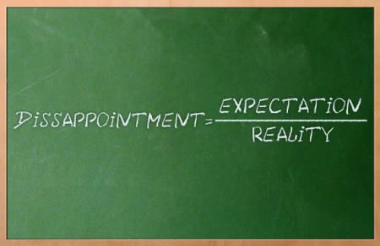
Setting Expectations
In-tro-duc-tion
Explain ‘what this is’
Both Code and Infrastructure
Together you get a clearer picture
DevOps
Configuration Through Code
Notes:
Introduction
The intent is to make you comfortable explaining to others at a high level what Service Fabric and Microservice Architectures are. If you are already actively working with Service Fabric, this likely isn’t the session for you.
Code and the Infrastructure
SvcFab is both the best and worst of IaaS and PaaS. It’s a powerful orchestration framework for microservices, but to leverage it fully, you also need to understand the infrastructure that supports it and how these two fit together.
DevOps
Service Fabric drags you kicking and screaming into the world of DevOps. You’ll need to understand the concept of configuration through code and how that impacts not just building your services, but also how they are deployed.
image from: https://thetechbench.wordpress.com/category/client-expectations/

Slide 4
Traditional application a.k.a Monolith
Compile-time contract validation
Local operations
Easier to reason about
Expensive to scale application
Hard to scale data access
Upgrades are a big deal
Notes:
For years we’ve been building n-tier applications. The influence of the “monolith” architectural style cannot be dismissed. This model, while this approach did solve some of the challenges of large scale solution development…
Communication contracts with compile time validation
Localized, internal communications
Discoverability… easy to understand, locate necessary functionality
But this approach does present some new challenges.
Monolithic solutions, while providing a separation of concerns, still results in the individual portions of an application being more tightly bound then their builders ever intended. This means that making significant changes is expensive and complicated. It also makes it more difficult to perform upgrades of individual portions of the system. It also presents challenges for scaling the solution if a limited number of aspects of the solution are the ones being overloaded.

Slide 5
Challenges of creating applications
Fragile environment
Webscale
Distributed teams
Frequent upgrades
Notes:
But the challenges don’t end there…
Monolithic solutions become fragile over time. They seem to breed dependencies between facets of the solution as well as the environment they are deployed in.
This type of architecture was born on-prem, in an “scale up” world. As such, they have difficulties trying to “scale out” when you try to turn them into externally consumable services.
When these solutions are not developed in a specific geography, but instead pulled together by teams spread around the globe, the dependencies are emphasized, and start to impede work getting done.
And as I’m sure some of you are well aware, these “technological terrors” are VERY difficult to upgrade frequently. Often there are detailed, complex plans required to perform upgrades and as a result you might update a solution only once or twice a year.

Slide 6

stateless
presentation services
Tiers of specific technologies
stateful
services
Single monolithic
database
stateless services
with
separate stores
Notes:
But solutions have evolved to try and address these issues. 10+ years ago, there was SOA which provided its own set of challenges. But recently a new standard has emerged, microservices.
By deconstructing the tiers of the monolithic application into smaller, more discrete services, we are able to decouple them, and allow us to manage and maintain them individually.

Slide 7
Microservices
Definition
Application created by connecting small, specialized services
Use bounded context that’s easily understandable
Use versioned interfaces for services
Service lifecycle owned by a small team
Benefits
Services are loosely coupled and independently deployable
Rapid development, innovation
Partitioned for scale and availability
Testability
Notes:
There are a significant amount of debate (mostly academic) about what exactly a microservice is. I’d caution you not to get too caught up in all this, and instead look at various approaches and find one that works best for you.
That said, there are some fairly common attributes:
An application is composed of multiple small, almost atomic services that each do one thing well
A service is specific to a bounded context (models of the business domain), providing a logical grouping of functionality
Services are clearly versioned.
The lifecycle of a service is owned by a small team, allowing them to remain agile and work independently of other services
The benefits will depend in large part on your implementation. But what you’re striving for is:
Loosely coupled, independent services that are easily deployable (few dependencies)
With such a small team and narrow functional scope, development cycles are short and agile. This increases the rate of development, delivery, and subsequently innovation
With this degree of granularity, it becomes much easier to validate the functionality of each service. And with versioning, you can ensure that backwards compatibility is maintained.
Notes
Bounded Context: http://martinfowler.com/bliki/BoundedContext.html

Slide 8
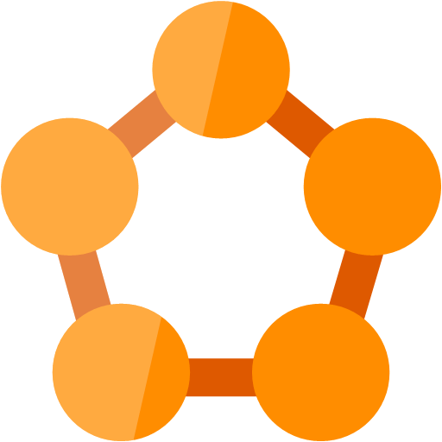
And from this was born Service fabric
An orchestration framework
A way to run, and manage microservices across a cluster of servers
Started Internally
Born inside Microsoft to build “cloud scale” solutions
Used by many of the most broadly used Azure and Office 365 services
Notes:
Elasticity scale-in scale-out / if needed scale up and down

Slide 9
Service Fabric
LifecycleMgmt
Independent Scaling
Independent Updates
Always On Availability
Resource Efficient
Stateless/
Stateful
Public Cloud
Other Clouds
Private cloud
Notes:
Next generation of PaaS on Azure
Elastic scale, OS updates, SF updates
Microservices platform for Windows and Linux
DevOps, rolling upgrades, etc.
Polycloud including on-premises
Programming models
Stateless Win32 apps written in any language (some feature not supported)
Reliable Services: Stateless & stateful (for hot data; gives low-latency reads)
OWIN/ASP.NET Core*
Service Fabric is free of charge
SDK: http://aka.ms/ServiceFabricSDK

Slide 10
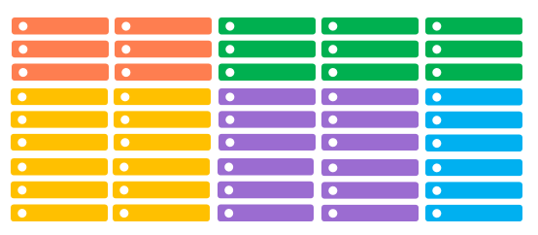
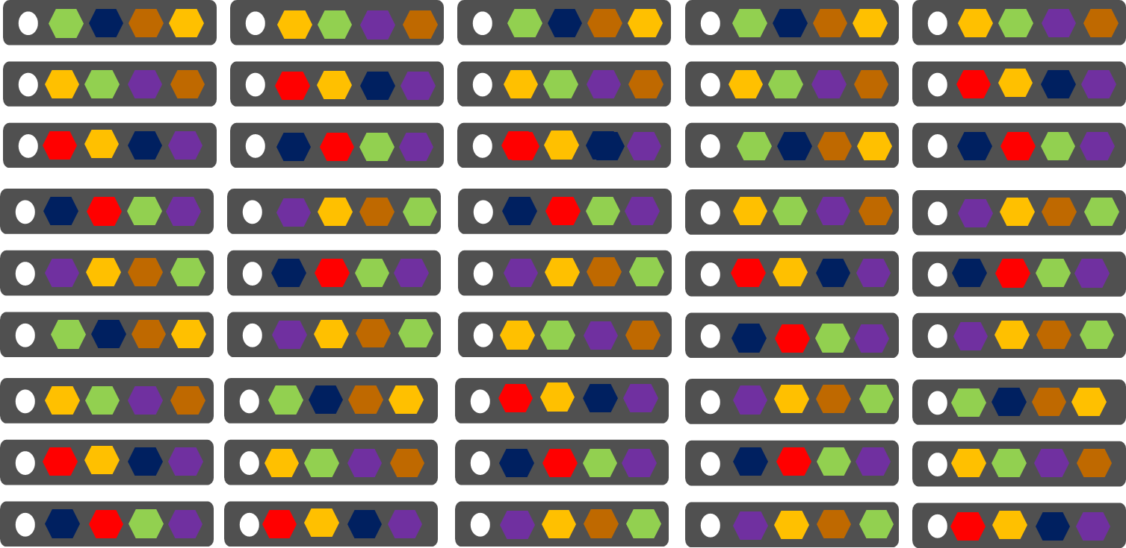
Conventional Services
Service Fabric
1 instance per VM (low density)
Uneven utilization
Slow scaling and failure recovery
Limited fault tolerance
Many services per VM (high density)
Even Utilization
Easier scaling of independent services
Tunable fast fault tolerance
Notes:
Now at this point, most introductions to service fabric would start discussing building services for Service Fabric. You’d see them deployed to a cluster and things would just magically work. But this isn’t one of those presentations. Instead, I’d like to take a few minutes to dispel some of the mystery around how this “microservice orchestration framework” differs from conventional approaches. And just as importantly, what makes up a “service fabric cluster”.
*click* Lets start with a conventional service deployment
Most of the time you’re going to deploy 1 copy of a server per host (usually a virtual machine). You’re also likely to have multiple hosts, with different capabilities… some with more RAM, some with more CPU, perhaps some with specialized hardware like GPUs. This creates an environment where utilization is uneven, some machines are under more load then others. It also limits the solutions ability to scale or be resilient to failures.
*click* The first thing service fabric does is provide a unified management plane across multiple hosts. Its these hosts (referred to as nodes) that comprise the cluster. It’s the visibility into these nodes that give the fabric the ability monitor the hosts, and manage the services to ensure their health.
*click* With this visibility, the fabric is able to distribute the services across the available nodes. And since the fabric is aware of the load on the nodes, it can place many services into the same node and adding additional copies of a service as you determine the need. It can even move them around if one node starts to experience problems.

Slide 11

Service Fabric Cluster
Ckuster supports 1,000s of nodes
Datacenter (Azure, Amazon, On-Premises)
PC/VM #2
Service Fabric
Your code, etc.
PC/VM #3
Service Fabric
Your code, etc. (Port: 19080)
PC/VM #1
Your code, etc.
Service Fabric
PC/VM #4
Load Balancer
Your code, etc.
Service Fabric
Your code, etc.
PC/VM #5
Web Request (Port: 80/443/?)
Service Fabric
Your code, etc.
Notes:
Lets take a closer look at what comprises a cluster.
Box representing cloud
Contains Cluster (can contain 1000s of nodes)
Contains Nodes (@ has name)
Endpoints
HttpGateWay (19007), Cluster (tcp: 19000)?
Your “static” code/data/config
Load Balancer
Animate: start w/DC box
Enter some nodes (names)
Install OS/SF
Establish endpoints to create cluster
You code/data/config
Load Balancer
Client request → LB → to a node
---
<?xml version="1.0" encoding="utf-8"?>
<!--
WARNING WARNING WARNING WARNING WARNING WARNING WARNING WARNING WARNING WARNING WARNING
WARNING WARNING WARNING WARNING WARNING WARNING WARNING WARNING WARNING WARNING WARNING
WARNING WARNING WARNING WARNING WARNING WARNING WARNING WARNING WARNING WARNING WARNING
The settings used within this ClusterManifest are expressly for use only
within a developer single-box environment. Any use of these settings outside
of that environment are highly likely to produce incorrect, and misperforming
systems.
WARNING WARNING WARNING WARNING WARNING WARNING WARNING WARNING WARNING WARNING WARNING
WARNING WARNING WARNING WARNING WARNING WARNING WARNING WARNING WARNING WARNING WARNING
WARNING WARNING WARNING WARNING WARNING WARNING WARNING WARNING WARNING WARNING WARNING
-->
<ClusterManifest
xmlns:xsd="http://www.w3.org/2001/XMLSchema"
xmlns:xsi="http://www.w3.org/2001/XMLSchema-instance"
xmlns="http://schemas.microsoft.com/2011/01/fabric"
Name="ComputerName-Local-Cluster"
Version="1.0">
<NodeTypes>
<NodeType Name="NodeType1">
<Endpoints>
<ClientConnectionEndpoint Port="19000" />
<LeaseDriverEndpoint Port="19001" />
<ClusterConnectionEndpoint Port="19002" />
<HttpGatewayEndpoint Port="19007" Protocol="http" />
<ServiceConnectionEndpoint Port="19006" />
<ApplicationEndpoints StartPort="30001" EndPort="31000" />
</Endpoints>
</NodeType>
<NodeType Name="NodeType2">
<Endpoints>
<ClientConnectionEndpoint Port="19010" />
<LeaseDriverEndpoint Port="19011" />
<ClusterConnectionEndpoint Port="19012" />
<HttpGatewayEndpoint Port="19017" Protocol="http" />
<ServiceConnectionEndpoint Port="19016" />
<ApplicationEndpoints StartPort="31001" EndPort="32000" />
</Endpoints>
</NodeType>
<NodeType Name="NodeType3">
<Endpoints>
<ClientConnectionEndpoint Port="19020" />
<LeaseDriverEndpoint Port="19021" />
<ClusterConnectionEndpoint Port="19022" />
<HttpGatewayEndpoint Port="19027" Protocol="http" />
<ServiceConnectionEndpoint Port="19026" />
<ApplicationEndpoints StartPort="32001" EndPort="33000" />
</Endpoints>
</NodeType>
<NodeType Name="NodeType4">
<Endpoints>
<ClientConnectionEndpoint Port="19030" />
<LeaseDriverEndpoint Port="19031" />
<ClusterConnectionEndpoint Port="19032" />
<HttpGatewayEndpoint Port="19037" Protocol="http" />
<ServiceConnectionEndpoint Port="19036" />
<ApplicationEndpoints StartPort="33001" EndPort="34000" />
</Endpoints>
</NodeType>
<NodeType Name="NodeType5">
<Endpoints>
<ClientConnectionEndpoint Port="19040" />
<LeaseDriverEndpoint Port="19041" />
<ClusterConnectionEndpoint Port="19042" />
<HttpGatewayEndpoint Port="19047" Protocol="http" />
<ServiceConnectionEndpoint Port="19046" />
<ApplicationEndpoints StartPort="34001" EndPort="35000" />
</Endpoints>
</NodeType>
</NodeTypes>
<Infrastructure>
<WindowsServer IsScaleMin="true">
<NodeList>
<Node NodeName="Node.1" IPAddressOrFQDN="localhost" IsSeedNode="true" NodeTypeRef="NodeType1" FaultDomain="fd:/FD01" UpgradeDomain="UD1" />
<Node NodeName="Node.2" IPAddressOrFQDN="localhost" IsSeedNode="true" NodeTypeRef="NodeType2" FaultDomain="fd:/FD02" UpgradeDomain="UD2" />
<Node NodeName="Node.3" IPAddressOrFQDN="localhost" IsSeedNode="true" NodeTypeRef="NodeType3" FaultDomain="fd:/FD03" UpgradeDomain="UD3" />
<Node NodeName="Node.4" IPAddressOrFQDN="localhost" IsSeedNode="false" NodeTypeRef="NodeType4" FaultDomain="fd:/FD04" UpgradeDomain="UD1" />
<Node NodeName="Node.5" IPAddressOrFQDN="localhost" IsSeedNode="false" NodeTypeRef="NodeType5" FaultDomain="fd:/FD05" UpgradeDomain="UD2" />
</NodeList>
</WindowsServer>
</Infrastructure>
<FabricSettings>
<Section Name="Security">
<Parameter Name="ClusterCredentialType" Value="None" />
<Parameter Name="ServerAuthCredentialType" Value="None" />
</Section>
<Section Name="FailoverManager">
<!-- expected cluster size allows the placement to start when the cluster is started. This value should be less than total number of nodes
as without it the FailoverManager will not start the placement of the user services. This value should be 80% to 90% of the cluster size.
-->
<Parameter Name="ExpectedClusterSize" Value="4" />
<!-- The default target and min replica set sizes are 7 and 5. The below configuration is not required for cluster that have 7 or more nodes. -->
<Parameter Name="TargetReplicaSetSize" Value="5" />
<Parameter Name="MinReplicaSetSize" Value="3" />
<Parameter Name="ReconfigurationTimeLimit" Value="20" />
<Parameter Name="BuildReplicaTimeLimit" Value="20" />
<Parameter Name="CreateInstanceTimeLimit" Value="20" />
<Parameter Name="PlacementTimeLimit" Value="20" />
</Section>
<Section Name="ReconfigurationAgent">
<Parameter Name="ServiceApiHealthDuration" Value="20" />
<Parameter Name="ServiceReconfigurationApiHealthDuration" Value="20" />
<Parameter Name="LocalHealthReportingTimerInterval" Value="5" />
<Parameter Name="IsDeactivationInfoEnabled" Value="true" />
</Section>
<Section Name="ClusterManager">
<!-- The default target and min replica set sizes are 7 and 5. The below configuration is not required for cluster that have 7 or more nodes. -->
<Parameter Name="TargetReplicaSetSize" Value="5" />
<Parameter Name="MinReplicaSetSize" Value="3" />
<Parameter Name="UpgradeStatusPollInterval" Value="5" />
<Parameter Name="UpgradeHealthCheckInterval" Value="5" />
<Parameter Name="FabricUpgradeHealthCheckInterval" Value="5" />
</Section>
<Section Name="NamingService">
<!-- The default target and min replica set sizes are 7 and 5. The below configuration is not required for cluster that have 7 or more nodes. -->
<Parameter Name="TargetReplicaSetSize" Value="5" />
<Parameter Name="MinReplicaSetSize" Value="3" />
</Section>
<Section Name="Management">
<Parameter Name="ImageStoreConnectionString" Value="file:C:\SfDevCluster\Data\ImageStore" />
<Parameter Name="ImageCachingEnabled" Value="false" />
</Section>
<Section Name="Hosting">
<Parameter Name="EndpointProviderEnabled" Value="true" />
<Parameter Name="RunAsPolicyEnabled" Value="true" />
<Parameter Name="DeactivationScanInterval" Value="60" />
<Parameter Name="DeactivationGraceInterval" Value="10" />
<Parameter Name="EnableProcessDebugging" Value="true" />
<Parameter Name="ServiceTypeRegistrationTimeout" Value="20" />
<Parameter Name="CacheCleanupScanInterval" Value="300" />
</Section>
<Section Name="HttpGateway">
<Parameter Name="IsEnabled" Value="true" />
</Section>
<Section Name="PlacementAndLoadBalancing">
<!-- balance the load on the cluster every 5 minutes. -->
<Parameter Name="MinLoadBalancingInterval" Value="300" />
</Section>
<Section Name="Federation">
<Parameter Name="NodeIdGeneratorVersion" Value="V3" />
</Section>
<Section Name="Trace/Etw">
<Parameter Name="Level" Value="4" />
</Section>
<!-- Configure the DCA to cleanup the log folder only. The collection of the logs, performance counters and crashdumps is not performed on the local machine. -->
<Section Name="Diagnostics">
<Parameter Name="ProducerInstances" Value="ServiceFabricEtlFile, ServiceFabricPerfCtrFolder" />
<Parameter Name="MaxDiskQuotaInMB" Value="10240" />
</Section>
<Section Name="ServiceFabricEtlFile">
<Parameter Name="ProducerType" Value="EtlFileProducer" />
<Parameter Name="IsEnabled" Value="true" />
<Parameter Name="EtlReadIntervalInMinutes" Value=" 5" />
<Parameter Name="DataDeletionAgeInDays" Value="3" />
</Section>
<Section Name="ServiceFabricPerfCtrFolder">
<Parameter Name="ProducerType" Value="FolderProducer" />
<Parameter Name="IsEnabled" Value="true" />
<Parameter Name="FolderType" Value="WindowsFabricPerformanceCounters" />
<Parameter Name="DataDeletionAgeInDays" Value="3" />
</Section>
<Section Name="TransactionalReplicator">
<Parameter Name="MaxStreamSizeInMB" Value="64" />
</Section>
</FabricSettings>
</ClusterManifest>

Slide 12
Lets take a look…
Content © Microsoft
Notes:
So lets take a look at two different clusters
Local machine (with SDK)
pull up the local copy of the portal http://localhost:19080
Cluster Services
Failover Manager: deals with nodes being added or removed from the cluster. Redistributing services as needed
Cluster Manager: works with the failover manager to place services on nodes
Naming Service: allows for discovery of services and their endpoints
Node distribution
Services (only addressable from within the cluster)
Process threads
Azure Hosted
Resource group – examine resources
Portal
Image Service: the application/service store. register and store packages. Doesn’t appear on the local cluster since its on the local disk

Slide 13
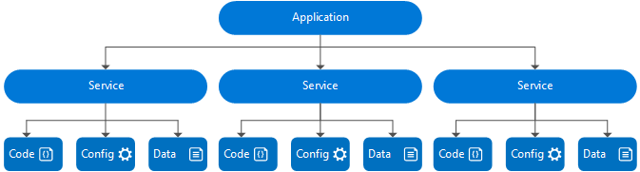
Application composition
Notes:
*click* An application:
Is a logical grouping of services
Is an upgrade unit. An upgrade targets an application instance
Can have different versions of the same application type side-by-side
instances of the same type get their own processes
*click* A service:
Is a logical grouping of partitions (and replicas/instances)
Is upgraded as part of an application upgrade (but you determine which ones to upgrade)
Can not have different versions of the same service type within an application
instances of the same type share a process
Image from: https://azure.microsoft.com/en-us/documentation/articles/service-fabric-application-model/

Slide 14
An Application
Declarative template (class) for creating an application (object)
Based on a set of service types
Used for packaging, deployment, and versioning
Application Type A
Service Type 1
Service Type 2
Service Type 3
Notes:
An application is service fabric a combination of services. It is defined declaratively using an xml based “application manifest” file. This is much like a traditional class definition in that manifest defines the application type. But it isn’t until its deployed to a fabric cluster that you have a running version. It’s the deployment of the application that instantiates an object from the class described in the manifest.
This is a largely logical construct. Allowing you to compose services together and assisting in the packaging of the services for deployment, as well as helping managing versioning. You can even

Slide 15
A Service
Services types are composed of code/config/data packages
Code packages define an entry point (dll or exe)
Config packages define service specific config information
Data packages define static resources (eg. images)
Packages can be independently versioned
<ServiceManifest Name="QueueService" Version="1.0">
<ServiceTypes>
<StatefulServiceType ServiceTypeName="QueueServiceType" HasPersistedState="true" />
</ServiceTypes>
<CodePackage Name="Code" Version="1.0">
<EntryPoint>
<ExeHost>
<Program>ServiceHost.exe</Program>
</ExeHost>
</EntryPoint>
</CodePackage>
<ConfigPackage Name="Config" Version="1.0" />
<DataPackage Name="Data" Version="1.0" />
</ServiceManifest>
Service Type 1
Code
Config
Data
Notes:
A service, much like the application is defined in a service manifest. A service is comprised of three packages:
Code – executable code that is what service fabric will “run”
Config – service specific configuration details (connection strings, endpoint configuration, etc…
Data – static resources needed by the service (images, data files)
Each of these packages can be independently versioned. This allows you to issue updates to just one while leaving the others alone.

Slide 16





Defining applications and services
Code
Config
Application Type
Application
Package
Counter
Service type
Unit of
Lifetime
Versioning
Isolation
Counter WebApp type
Counter
Service
Pkg
Counter
WebApp
Pkg
Notes:
So lets review..
*click* We have services that are composed of items like code and configuration details.
*click* These components are packaged together to form the service package.
*click* That service is possibly combined with others, forming an application. And subsequently deployed to the cluster. That application package gives us a way to manage those services throughout their lifetime.

Slide 17
Service Fabric service “templates”
Stateless microservice
Has either no state or it can be retrieved from an external store
There can be N instances
e.g. web frontends, protocol gateways, Azure Cloud Services etc.
Stateful microservice
Maintain hard, authoritative state
N consistent copies achieved through replication and local persistence
e.g. database, documents, workflow, user profile, shopping cart etc.
Guest Executables
Allows you to run non-service fabric services
Notes:
Each Service Fabric service is based on a “template” service type.
*click* Stateless services are ones that do not contain any internally stored state. Either because they don’t have any state, or they have pushed it out to an external store. Stateless services, because they lack the overhead of state, can be easily moved around or scaled up and down as needed. They are great for web based front ends or simple processing.
*click* Stateful services maintain data, or state within them. They have mechanism unique to Service fabric to ensure that this state is synchronized across instances of the service (referred to as replicates). The state can also be persisted internally in memory, on the disk of the node that’s running the service, or even pushed out to an external store. Stateful services also have feature “partitions” which is a way of spreading the load against the state out. Given them a unique capacity to scale out.
*click* And finally we have guest executables. This type of service allows you to run something that’s not a native service fabric service or application. It could be a node application, perhaps something with OWIN, or maybe even a docker container. The choice is yours. Service Fabric will just attempt to keep as many copies of this “service” running as you tell it.
As a final note, if you think back to when were looking at the Service Fabric cluster, you remember those “system” services. They were created using these same service templates.

Slide 18


Stateful Services & Reliable Collections
IReliableDictionary<K,V>
IReliableQueue<T>
Data is replicated between nodes/instance for high availability
Transactional, across collections
Multiple transaction isolation levels
Data can be backed up and restored
Flexible persistence model
Notes:
Stateful services maintain state using a reliable collection. The dictionary and the queue. The dictionary provides a key/value pair mechanism for storing and retrieving data. The queue provides a simple FIFO mechanism. These collections are hosted within a stateful service which acts as the interface for interacting with it. The portioning we mentioned for stateful services in mirrored in the reliable collection.
While these collections are a natural evolution of their .Net cousins, within service fabric, they gain some new and unique functionality..
*click* Reliable collections replicate their state to secondary instances of the service. For each service, you get one primary, and multiple secondary instance. The fabric keeps track of which one is the primary on your behalf so clients interacting with the service don’t have too.
*click* Reliable collections support transaction control. This scope extends across collections and operations. This includes being able read from within a transaction and getting results based on the pending state.
*click* With multiple levels of isolation within a transaction, allowing the locking (or not) of data that is being modified.
*click* And for .Net Developers, these collections support LINQ queries. ☺
*click* The data contained inside of a collection can be stored in memory (great for caching solutions), placed on the local disk of the host node, or pushed to an external state store as needed.
Notes:
https://azure.microsoft.com/en-us/documentation/articles/service-fabric-reliable-services-quick-start/

Slide 19
A couple service … restrictions
Classic ASP is out, Service Fabric and IIS don’t play well together
OWIN or ASP.NET Core are fine
Any object going into a reliable collection must be serializable
Notes:
Stateful services maintain state using a reliable collection. These collections are natural extensions of two .Net collection types. The dictionary and the queue. The dictionary provides a key/value pair mechanism for storing and retrieving data. The queue provides a simple FIFO mechanism. Anything stored in either of these collections much be serializable.
But with service fabric, they gain some new and unique functionality

Slide 20
Service Fabric Orchestration - Rules
Fault and Upgrade Domains (topology awareness)
Fault Domains -> Areas of Independent, Uncorrelated Failures: Power Sources, etc
Upgrade Domains -> No Downtime Rolling Upgrades
Placement Constraints
Tag nodes with properties and values
Select specific workloads for certain nodes, ex: (HasGPU == True)
Node Capacity
Don’t overload nodes
React to changes in resource consumption
React to overloaded nodes quickly

Slide 21
Service Fabric Orchestration - Optimizations
Default Metrics
Prevent basic workloads from clumping up in the cluster
Custom Metrics
Allow applications to define resources they care about, balance them in the cluster to prevent hot/cold nodes
Metric Weights
Preferences for fixing one metric vs. another, ex: “Memory is More Important than Disk for this Service”
Proactive Rebalancing w/ Triggers
“The cluster may be only so imbalanced before Service Fabric should react”
Movement Cost
Some Services are smaller and easier to move
If we can fix issues in the cluster without moving the “big” workloads, prefer these solutions

Slide 22
Service Fabric – failover
X
Failed
Types of reconfiguration
Primary failover
Removing a failed secondary
Adding recovered replica
Building a new secondary
Replica States
None
Idle Secondary
Active Secondary
Primary
P
S
P
B
S
X
S
Failed
S
S
Must be safe in the presence of cascading failures

Slide 23
On Applications, Hosts & Activation
Applications are packages, copied to the cluster (System:Image Store Service), then registered as ApplicationType and ApplicationTypeVersion with Service Fabric.
Application instance is based on ApplicationType & ApplicationTypeVersion defines process isolation boundaries, while partition defines data isolation boundaries.
ApplicationManifest’s DefaultServices are activated with every app instance.
VS.NET tooling creates 1 App Instance when you F5 or Publish.
Services are defined as a ServiceType with ServiceTypeVersion in a Service Package that also has Code, Config & Data packages (each package is versioned).
Code = host, host is a process created per node per Application per service type. Optionally: can also have a Setup EntryPoint. Replicas are activated in host process.
Notes:
Stephane

Slide 24
On Rolling Upgrades
Hosts are taken down during Code package updates, but not during Config or Data packages upgrades.
Upgrades are performed on Cluster Update Domains.
Upgrades Types
Monitored Auto: UD one by one , health checks and failure action: (can do auto roll back).
Unmonitored Auto: UD one by one, no health checks.
Unmonitored Manual: You manually upgrade each UD.
* use Upgrade Parameters to control the upgrade process.
Notes:
Stephane

Slide 25
Application Upgrade
Upgrade Domain #1
Upgrade Domain #2
Upgrade Domain #3
App Repository
Windows OS
Windows OS
App A v1
Windows OS
App C v2
App A v1
App C v1
Fabric
Node
App B v2
Fabric
Node
Fabric
Node
App B v2
App C v2
App C v1
App C v1
App C v2
Windows OS
Windows OS
Windows OS
Fabric
Node
App B v2
App C v2
App B v2
App C v1
Fabric
Node
App A v1
App A v1
Fabric
Node
Notes:
Stephane

Slide 26
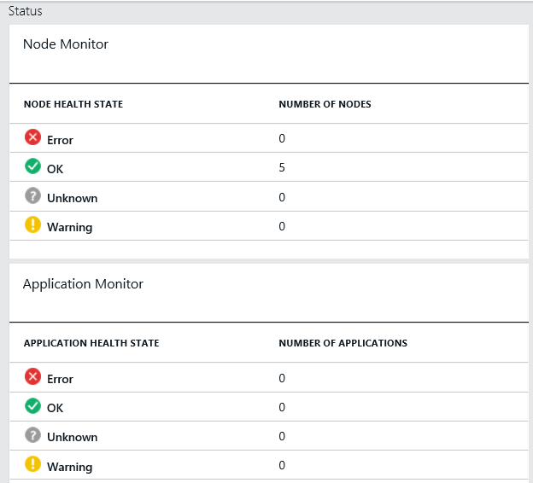
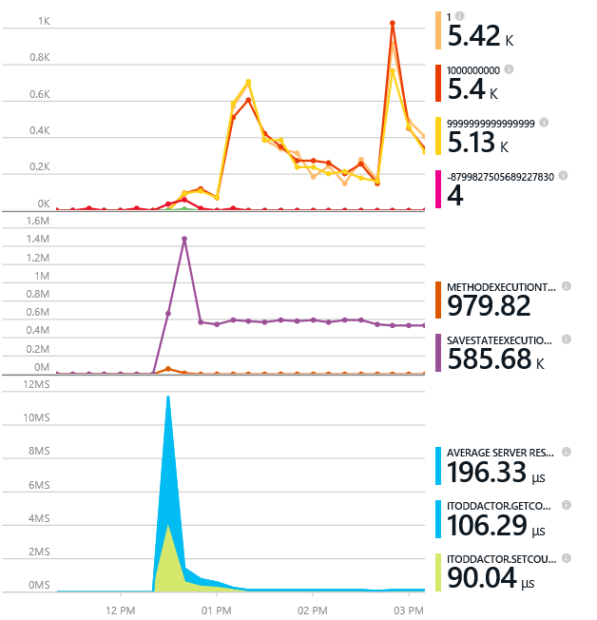
Monitoring your Services
Health status monitoring
Built-in health status for cluster and services
Flexible and extensible health store for custom app health reporting
Allows continuous monitoring for real-time alerting on problems in production
Performance and stress response
Rich built-in metrics for Actors and Services programming models
Easy to add custom application performance metrics

Slide 27
Diagnostics and Troubleshooting
Detailed System Optics
Repair suggestions. Examples: Slow RunAsync cancellations, RunAsync failures
All important events logged. Examples: App creation, deploy and upgrade records. All Actor method calls.
Custom Application Tracing
ETW == Fast Industry Standard Logging Technology
Works across environments. Same tracing code runs on devbox and also on production clusters on Azure.
Easy to add and system appends all the needed metadata such as node, app, service, and partition.
Choice of Tools
Visual Studio Diagnostics Events Viewer
Windows Event Viewer
Windows Azure Diagnostics + Operational Insights
Easy to plug in your preferred tools: Kibana, Elasticsearch and more

Slide 28

A Platform for Microservices is not Free
Problems to Solve
Service Availability
Resource Allocation
State Management
Versioning
Independently upgradable services / data
Roll backs
You provide the design & code
You can still write monolithic applications and do bad things!

Slide 29
Interested in More?
https://aka.ms/brent-servicefabric-intro
Content © Microsoft
Notes:
Too many learning materials to list here. I’ve put some of my favorites on my blog along with a link to this presentation. Enjoy and check back for updates as things continue to mature.

Slide 30

Thank you!
https://aka.ms/brent-servicefabric-intro
Brent Stineman
DX/TED, Azure Specialist, Cloud Evangelist
Email: brestin@microsoft.com
Twitter: @brentcodemonkey
Web: http://brentdacodemonkey.wordpress.com
→
Creating quality bugs since 1992!
Notes:
Image Courtesy of Brent.
Purple dye all over his face is courtesy of his daughter

